Slide 1
Oesophagus
Prepared by:
Dr. Muntadher Abdulkareem Abdullah
M.B.Ch.B,CABM,FIBMS,FIBMS(GE.&HEP.)

Slide 2
Objectives:
At the end of this lecture you must know:
1.What is the GERD ?, its complications , how you diagnose and mange these complications.
2.What is Barret Oesophagus?
3.What are the motility disorders of the Oesophagus ?, diagnosis and managements.
4. What are the tumours of the Oesophagus?

Slide 3
Anatomy, histology and physiology of the Oesophagus

Slide 4
The esophagus, which averages about 27 cm in length, is a hollow muscular tube consisting of mucosa, submucosa, and muscularis layers and the absence of a serosal layer.
The mucosa is a stratified squamous nonkeratinized epithelium that transitions to a columnar epithelium at the gastroesophageal junction.
The muscular layer of the esophagus is composed of striated muscle in the upper one third and smooth muscle in the lower two thirds. These muscular components are arranged as an inner circular and an outer longitudinal layer. Located between the circular and longitudinal muscle layers is Auerbach’s (myenteric) plexus, whereas Meissner’s plexus is located within the submucosa and innervates the muscularis mucosae.
The esophagus is bounded by an upper esophageal sphincter proximally and the lower esophageal sphincter distally. The motor functions of the esophagus are to transport a food bolus from the oropharynx into the stomach and then to keep food from returning to the esophagus after it has entered the stomach.

Slide 5
Symptoms of Esophageal Disease
The most common symptom of esophageal disease is heartburn, which is defined as a sensation of substernal burning.
Chest pain without typical heartburn may occur in a variety of esophageal disorders, including gastroesophageal reflux and motor disorders such as in achalasia. However, esophageal pain and even heartburn can be indistinguishable from cardiac angina, so care must be taken when a patient at risk for coronary artery disease complains of heartburn for the first time.
Dysphagia, or difficulty swallowing, is another cardinal symptom of esophageal disease. Dysphagia with only solid food tends to occur with structural lesions, which cause esophageal constriction, whereas dysphagia with both liquids and solids occurs more often with motility disorders.
Patients with oropharyngeal dysphagia will commonly complain of a feeling of food “sticking” in the throat or the inability to propel the bolus from the mouth to the pharynx; they may also complain of the need for multiple swallowing motions to clear the bolus. Because the cranial nerves that generally control the initial phases of swallowing are responsible for other functions as well, symptoms that may be associated with oropharyngeal dysphagia include drooling, dysarthria (due to tongue dysfunction), nasal regurgitation (due to failure to seal off the nasal passage), or coughing and aspiration (due to failure to elevate and cover the laryngeal vestibule).
Dysphagia that results from abnormalities in the body of the esophagus may be referred to the chest or the neck, so the location of pain does not predict the location of the disease.
Dysphagia may also lead to a variety of behavioral accommodations, including maneuvers such as slow eating, food aversion, avoidance of hard solid food, and drinking of large amounts of liquids with solid meals.

Slide 6
Regurgitation, which is another typical esophageal symptom, may be described as the feeling of food coming up into the chest or, more
dramatically, into the mouth. When regurgitation occurs early in the meal, it suggests a proximal lesion. Regurgitation later in the meal suggests
a motility abnormality such as achalasia.
Food impaction is an extreme esophageal symptom. When impaction occurs in the oropharynx, patients may develop a “steakhouse”
syndrome, in which an impacted food bolus leads to tracheal impaction or compression. With more distal esophageal lesions, impaction may
occur any time during the meal, almost always from a mechanical cause. Patients experience the sudden onset of chest pain and the sensation
of food sticking, typically after solids such as meats, raw vegetables, and sometimes sticky rice. With complete impaction, patients who cannot
handle secretions because of the obstructing bolus are at risk of aspiration.

Slide 7
Disorders of the Oesophagus
GASTROESOPHAGEAL REFLUX DISEASE:
Gastroesophageal reflux disease (GERD) develops when the reflux of stomach contents into the esophagus causes troublesome symptoms or complications.
EPIDEMIOLOGY:
It is estimated that GERD, defined as at least weekly heartburn or acid regurgitation, has a prevalence ranging from 10 to 20% in the Western world and less than 5% in Asia.
The prevalence also tends to be higher in North America than Europe and higher in northern Europe than in southern Europe. Risk factors for developing GERD include obesity and possibly increasing age.
A genetic component may also play a role.
The esophagus is protected from the harmful effects of refluxed gastric contents by the antireflux barrier at the gastroesophageal junction, by esophageal clearance mechanisms, and by epithelial defensive factors.

Slide 8
Reflux of gastric contents from the stomach into the esophagus occurs in healthy individuals, but refluxed gastric contents are normally cleared in a two-step process: volume clearance by peristaltic function and neutralization of small amounts of residual acid by weakly alkaline swallowed saliva.
In normal healthy individuals, physiologic reflux occurs primarily when the lower esophageal sphincter transiently relaxes in the absence of a swallow because of a vagally mediated reflex that is stimulated by gastric distention.
In GERD patients, transient relaxation of the lower esophageal sphincter or a low resting lower esophageal sphincter pressure can result in regurgitation, especially when intra-abdominal pressure is increased.
A hiatal hernia, which results in spatial separation between the augmenting effects of the crural diaphragm and the lower esophageal sphincter, predisposes to reflux events by widening the opening of the gastroesophageal junction and decreasing the pressure of the lower esophageal sphincter.
Obesity results in an increase in intragastric pressure, which increases the gastroesophageal pressure gradient and the frequency of transient lower esophageal sphincter relaxation, thereby predisposing gastric contents to migrate into the esophagus. In addition, obesity enhances the spatial separation of the crural diaphragm and the lower esophageal sphincter, thereby predisposing obese individuals to a hiatal hernia.

Slide 11
CLINICAL MANIFESTATIONS
The classic symptoms of GERD are heartburn and acid regurgitation; atypical symptoms include chest pain, dysphagia, and odynophagia.
Extraesophageal manifestations of reflux disease can include cough , laryngitis , asthma , and dental erosions, but these symptoms can be
reliably attributed to reflux only if they are accompanied by classic signs and symptoms of reflux disease.
Other proposed associations that are not clearly established include pharyngitis, sinusitis, otitis media, and idiopathic pulmonary fibrosis.
When excessive gastric contents overwhelm the mucosal protective factors in the esophagus, esophagitis may be manifest as erosions or
ulceration of the esophagus and may also lead to fibrosis with stricturing, columnar metaplasia (Barrett’s esophagus) or esophageal
adenocarcinoma . However, approximately two thirds of individuals with reflux symptoms have no evidence of esophageal damage by endoscopy.
DIAGNOSIS:
When GERD presents with typical signs and symptoms, such as heartburn or acid regurgitation, that are responsive to antisecretory therapy, no
diagnostic evaluation is warranted.
Diagnostic endoscopy is warranted in individuals who fail to respond to therapy or have alarm symptoms or signs such as dysphagia , weight loss,
anemia, gastrointestinal bleeding, or persistent heartburn .

Slide 12
Endoscopy permits the detection of erosive esophagitis and complications such as a peptic stricture and Barrett’s esophagus ; mucosal biopsy, which is crucial in these settings, also excludes conditions that can mimic GERD, such as eosinophilic esophagitis. However, most patients have no mucosal damage seen on endoscopy, regardless of whether they are on or off antisecretory therapy.
24 Oesophageal PH monitoring and impedance if the diagnosis is unclear or as a preoperative assessment .
TREATMENT:
Life style modifications: include the followings:
1.Avoidance of foods or beverages that may provoke symptoms, such as alcohol, coffee, spicy foods, and late meals, makes physiologic sense, data from clinical trials to support these maneuvers are lacking.
2.Similarly, elevation of the head of the bed for patients with nocturnal regurgitation or heartburn also is logical.
3.Given the association of obesity and GERD symptoms, weight loss should be part of any treatment program for obese patients.
Pharmacological treatments:
Inhibition of gastric acid secretion is the cornerstone of the acute treatment of GERD, and proton pump inhibitors (PPIs) are superior to histamine (H2)-receptor antagonists for both the healing of esophagitis and the control of symptoms. However, the healing of esophagitis is more predictable than improvement in heartburn symptoms, even with PPIs. 2 There are no major differences in treatment efficacy among the various PPIs, and once-daily dosing is adequate.
Surgical managements:
For medically refractory disease , patients with side effects of medications and those not want to use long term medication and for correction of associated hiatus hernia.
The antireflux surgery called Nissen fundoplication usually done laparoscopically nowadays.

Slide 13
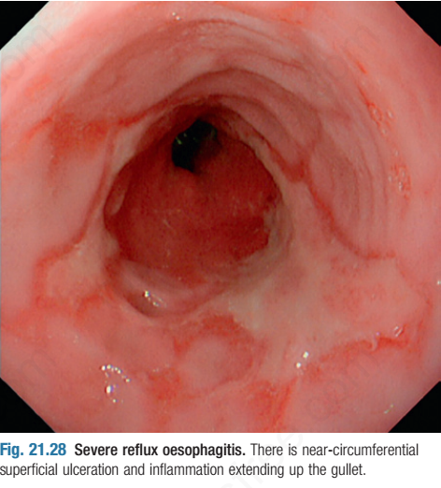
GERD complications:
1.Oesophagitis
2.Barret Oesophagus
3.Anaemia
4.Begnin Oesophageal stricture
5.Oesophageal adenocarcinoma
The oesophagitis:
A range of endoscopic findings is recognized, from mild redness to severe bleeding ulceration with stricture formation, although appearances may be completely normal. There is a poor correlation between symptoms and histological and endoscopic findings.

Slide 14
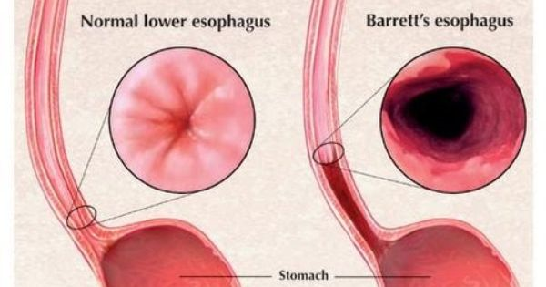
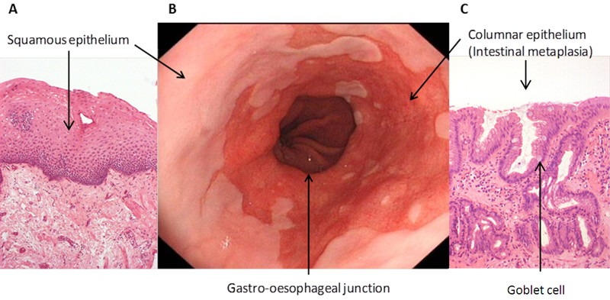
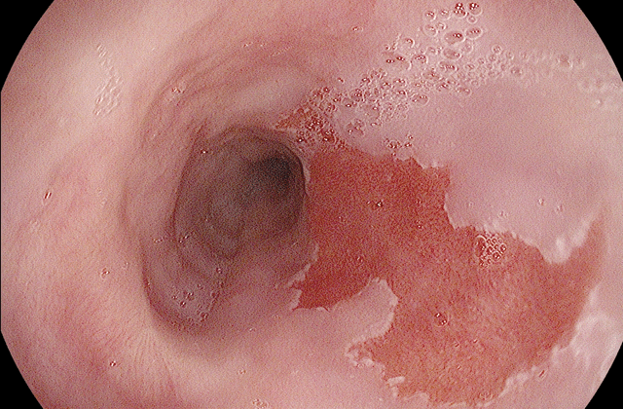
Barrett’s Oesophagus
Barrett’s Oesophagus is a pre-malignant condition, in which the normal squamous lining of the lower Oesophagus is replaced by columnar mucosa (columnar lined Oesophagus; CLO) that may contain areas of intestinal metaplasia .

Slide 15
It is an adaptive response to chronic gastro-oesophageal reﬂux and is found in 10% of patients undergoing gastroscopy for reﬂux symptoms. Community-based epidemiological studies suggest that the true prevalence may be up to 1.5–5% of the population, as the condition is often asymptomatic until discovered when the patient presents with Oesophageal cancer.
The relative risk of oesophageal cancer is increased 40–120-fold but the absolute risk is low (0.1–0.5% per year).
Risk Factors of Barret Oesophagus:
1.Prolong duration of GERD
2. White male over 50 years
3.Obesity especially increase in waist circumference.
4. It is weakly associated with smoking but not alcohol intake.
Risk of adenocarcinoma development in the setting of Barret Oesophagus:
The risk of cancer seems to relate to the severity and duration of reﬂux rather than the presence of Barrett’s Oesophagus per se, and it has been suggested that duodenogastro-oesophageal reﬂux of bile, pancreatic enzymes and pepsin, as well as gastric acid,
Diagnosis:
This requires multiple systematic biopsies to maximise the chance of detecting intestinal metaplasia and/or dysplasia.
Management:
Neither potent acid suppression nor anti-reﬂux surgery stops progression or induces regression of Barret Oesophagus, and treatment is indicated only for symptoms of reﬂux or complications, such as stricture. .

Slide 16
Endoscopic therapies:
such as radiofrequency ablation or photodynamic therapy, can induce regression but at present are used only for those with dysplasia or intramucosal cancer.
Regular endoscopic surveillance can detect dysplasia at an early stage and may improve survival but, because most Barrett’s Oesophagus is undetected until cancer develops, surveillance strategies are unlikely to inﬂuence the overall mortality rate of oesophageal cancer.
Surveillance:
It is currently recommended that patients with Barrett’s Oesophagus with intestinal metaplasia, but without
dysplasia, should undergo endoscopy at 3–5-yearly intervals if the length of the Barrettic segment is less than 3
cm and at 2–3-yearly intervals if the length is greater than 3 cm.
Those with low-grade dysplasia should be endoscoped at 6-monthly intervals.
For those with high-grade dysplasia or intramucosal carcinoma, the treatment options are either oesophagectomy
or endoscopic therapy, with a combination of endoscopic resection of any visibly abnormal areas and
radiofrequency ablation of the remaining Barrett’s mucosa, as an ‘organ-preserving’ alternative to surgery.
These cases should be discussed in a multidisciplinary team meeting and managed in specialist centres .

Slide 17
Anaemia :
1.Iron defciency anaemia can occur as a consequence of occult blood loss from long-standing oesophagitis.
2.Cameron ulcer: a large hiatus hernia and bleeding can stem from subtle erosions in the neck of the sac .
3.Other causes unrelated to GERD especially colorectal cancer.

Slide 18
Other causes of oesophagitis
Infection:
Most common causes include candida, herpes simplex virus and cytomegalovirus, these mainly occurred in immune suppressed patients.
Corrosive Oesophagitis:
Most commonly caused by strong household bleach and battery acid usully occur as a suicidal attempts or intentionally in children and mentally retarded personnels.
This result in severe oesophagitis, perforation , mediastinitis and long term complicated by oesophageal stricture and cancer.
Drugs:
Include potassium supplements, NSAIDS, Antibiotics mainly tetracycline and doxycycline, Bisphosphonate, oral iron supplements and others.
Eosinophilic Oesophagitis:
A common cause of food impaction in adults causing what is called steakhouse syndrome.
Complication is oesophageal stricture.
Diagnosis usually by endoscopic biopsies from distal and proximal Oesophagus that show >15 eosinophil/hpf in addition to target biopsies from any lesion caused by the eosinophilic esophagitis that include: Ring, web,furrows,ulcers.
Treatment with swallowed steroids like fluticasone or betamethasone and refractory symptoms may respond to montelucast , a leukotriene inhibitor.

Slide 19
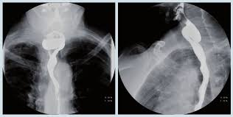
Motility disorders of the Oesophagus
1.Pharyngeal pouch(Zenker’s diverticulum):
This occurs because of incoordination of swallowing within the pharynx, which leads to herniation through the cricopharyngeus muscle and formation of a pouch.
Patient usually presented with dysphagia, halitosis and regurgitation and sometimes the patient may feel gurgling in the neck or it can be usually asymptomatic.
The investigation of choice is the a barium swallow.
Surgical myotomy (‘diverticulotomy’), with or without resection of the pouch, is indicated in symptomatic patients.

Slide 20
Achalasia of the Oesophagus
Achalasia is characterised by:
• a hypertonic lower oesophageal sphincter, which fails to relax in response to the swallowing wave
• failure of propagated oesophageal contraction, leading to progressive dilatation of the Oesophagus.
The cause is unknown. Defective release of nitric oxide by inhibitory neurons in the lower oesophageal sphincter has been
reported, and there is degeneration of ganglion cells within the sphincter and the body of the Oesophagus. Loss of the
dorsal vagal nuclei within the brainstem can be demonstrated in later stages. Infection with Trypanosoma cruzi in Chagas’
disease causes a syndrome that is clinically similar to achalasia.
Clinical features :
Usually is that of dysphagia , This develops slowly, is initially intermittent, and is worse for solids and eased by drinking liquids and by standing and moving around after eating.
Heartburn does not occur because the closed oesophageal sphincter prevents gastro-oesophageal reﬂux.
Some patients experience episodes of chest pain due to oesophageal spasm.
As the disease progresses, dysphagia worsens, the Oesophagus empties poorly and nocturnal pulmonary aspiration develops.
Achalasia predisposes to squamous carcinoma of the Oesophagus.

Slide 21
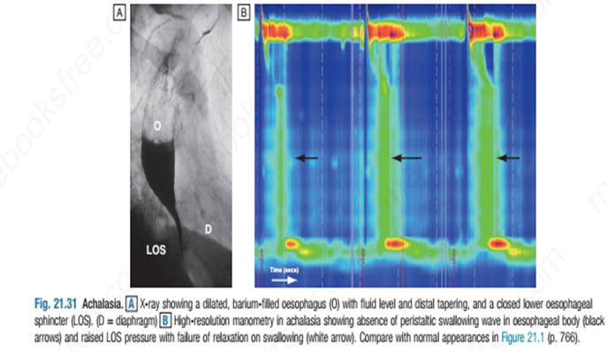
Investigations
1.Barium swallow: shows tapered narrowing of the lower Oesophagus and, in late disease, the oesophageal body is dilated, aperistaltic and food-filled.
2.Endoscopy : should always be carried out because carcinoma of the cardia can mimic the presentation and radiological and manometric features of achalasia (‘pseudo-achalasia’).
3. Manometry confirms the high-pressure, non-relaxing lower oesophageal sphincter with poor contractility of the oesophageal body.

Slide 22
Management
Endoscopic:
1.Forceful pneumatic dilatation using a 30–35-mm-diameter.
2. Endoscopically directed injection of botulinum toxin into the lower oesophageal sphincter .
3. Recently, a complex endoscopic technique has been developed in specialist centres (peroral endoscopic myotomy, POEM).
Surgical:
Surgical myotomy (Heller’s operation), performed either laparoscopically or as an open operation.
Both pneumatic dilatation and myotomy may be complicated by gastro-oesophageal reﬂux, and this can lead to severe oesophagitis because oesophageal clearance is so poor. For this reason, Heller’s myotomy is accompanied by a partial fundoplication anti-reﬂux procedure. PPI therapy is often necessary after surgery.
Pharmacological therapy :
For patient cannot undergo endoscopic or surgical therapy .
This include the use of calcium channel blockers and nitrite.
Other oesophageal motility disorders:
like diffuse oesophageal spasm, nutcracker Oesophagus and jackhammer Oesophagus.
The differentiation between them is by oesophageal Manometry .

Slide 23
Secondary causes of oesophageal dysmotility
In systemic sclerosis or CREST syndrome , the muscle of the Oesophagus is replaced by fibrous tissue, which causes failure
of peristalsis leading to heartburn and dysphagia.
Oesophagitis is often severe and benign fibrous strictures occur. These patients require long-term therapy with PPIs.
Dermatomyositis, rheumatoid arthritis and myasthenia gravis may also cause dysphagia.
Pseudo achalasia:
This is usually occur in old people above 60s with rapid development of symptoms over short term compare with idiopathic achalasia , patient usually developed symptoms of dysphagia to solid food then to liquid with progressive weight loss.
The cause is that of infiltrative disease at the gastroesophageal junction like carcinoma of cardia or metastatic malignant deposit to this area.
Investigation include :
CT or MRI of the lower Oesophagus, endoscopy with biopsy and endoscopic ultrasound with biopsy.

Slide 24
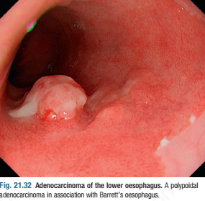
Tumours of the Oesophagus
Benign tumours:
The most common is a leiomyoma. This is usually asymptomatic but may cause bleeding or dysphagia.
Carcinoma of the Oesophagus: either squamous or adenocarcinoma.
Squamous cancer can occur in any part of the Oesophagus and almost all tumours in the
upper Oesophagus are squamous cancers.
Adenocarcinomas more common ,typically arise in the lower third of the Oesophagus from Barrett’s
Oesophagus or from the cardia of the stomach .
Risk factors for squamous cell carcinoma:
•Smoking
• Alcohol excess
• Chewing betel nuts or tobacco
• Achalasia of the Oesophagus
• Coeliac disease
• Post-cricoid web(plummar-vinson syndrome) in patient with long standing IDA
• Post-caustic stricture
• Tylosis (familial hyperkeratosis of palms and soles)

Slide 25
Risk factors for oesophageal adenocarcinoma:
1.Barret Oesophagus
2.GERD
3.Obesity, Male
4.Old age
5.Smoking
Clinical features: Dysphagia, chest pain, upper GI bleeding , weight loss and features of distant and local metastasis
Diagnosis : Radiological : CT chest or MRI with contrast , OGD with biopsy
Treatment : oesophagectomy for resectable fit patient , chemotherapy , radiotherapy for unresectable disease or palliative treatment for advanced disease.

Slide 26
THANKS

